Slide 1

STUDENT PERFORMANCE IN EXAM CASE STUDY
A Research Project By Chandrima Thakur

Slide 2
CONTENTS
CASE STUDY
OBJECTIVES
DATA ANALYSIS
CATEGORIZATION
CONCLUSION

Slide 3
CASE STUDY
The Case-Study consist of only one data set that is Student Performance.
The Case Study consist of 1000 student records based on their performance.

Slide 4
OBJECTIVES
ANALYSE THE STUDENT PERFORMANCE DATA AND DETERMINE HOW EACH FACTORS ARE AFFECTING THEIR PERFORMANCE .
TO PUBLISH THE FINDINGS BASED ON DATA ANALYSIS AND DRAW CONCLUSIONS FOR BETTER PERFORMANCE IN FUTURE.

Slide 5
DATA ANALYSIS
GENDER : MALE AND FEMALE
RACE: GROUP A,GROUP B,GROUP C
GROUP D AND GROUP E
PARENT EDUCATION: BACHELOR’S
DEGREE,SOME COLLEGE,MASTER’S
DEGREE,ASSOCIATE’S DEGREE,HIGH
SCHOOL AND SOME HIGH SCHOOL
LUNCH: STANDARD AND
FREE/REDUCED
TEST PREPARATION COURSE: NONE AND COMPLETED
WRITING SCORE,READING SCORE
AND MATH SCORE: DIFFERENT
SCORES OF STUDENTS

Slide 6
CATEGORIZATION

Slide 7
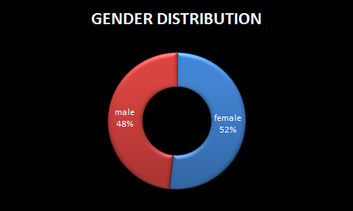
CATEGORIZATION BASED ON GENDER
FINDINGS:
The number of male student is less than the number of female student

Slide 8
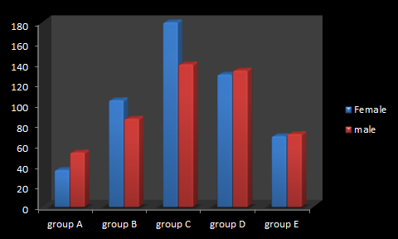
CATEGORIZATION BASED ON RACE AND GENDER
FINDINGS:
The Students that belong to race GROUP A are very less.
The maximum Students are from race GROUP C and GROUP D.
The maximum male and female students belong to GROUP C.

Slide 9
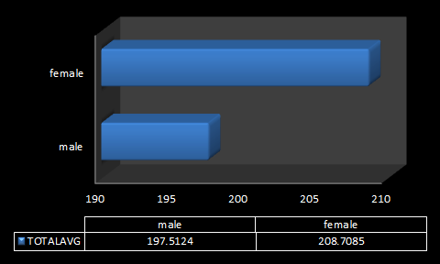
CATEGORIZATION BASED ON GENDER-WISE PERFORMANCE
FINDINGS:
The Female Students have a better Performance than the Male Students

Slide 10
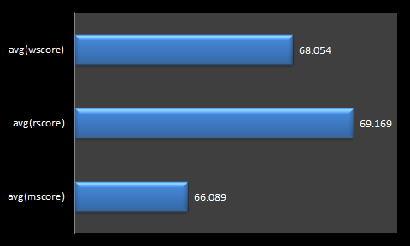
CATEGORIZATION BASED ON SUBJECTS
FINDINGS:
The Students are performing well in Reading and Writing.
The Students have lower Performance in Maths.

Slide 11
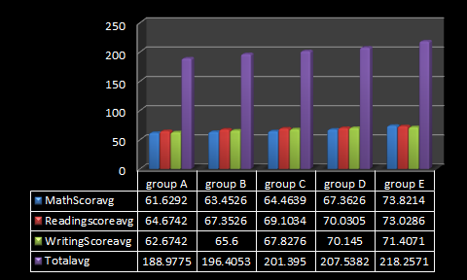
CATEGORIZATION BASED ON OVERALL PERFORMANCE
FINDINGS:
The Students that belong to race GROUP E are the highest performers.
The Students that belong to race GROUP C and GROUP D are the average performers.
The Students that belong to race GROUP B and GROUP A are the least performers.

Slide 12
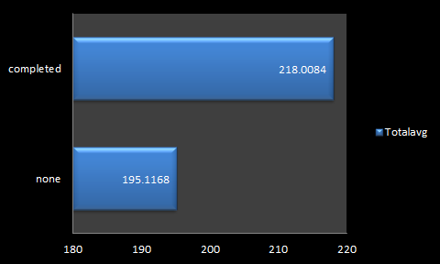
CATEGORIZATION BASED ON TEST PREPARATION COURSE
FINDINGS:
The Students that have opted and completed the Test Preparation Course have performed well comparatively to the Students that have no Test Preparation Course.

Slide 13
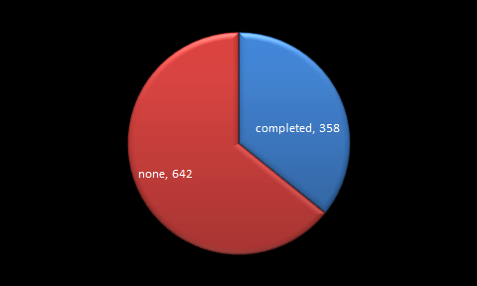
CATEGORIZATION BASED ON TEST PREPARATION COURSE
FINDINGS:
Very Less Students have opted for Test Preparation Course.
Maximum amount of Students have No Test Preparation Course.

Slide 14
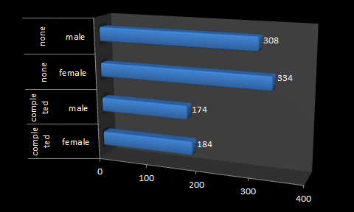
CATEGORIZATION BASED ON TEST PREPARATION COURSE AND GENDER
FINDINGS:
The number of male and female students are more who have not taken the course.The number of Female students is more than the number of Male Students.
The number of Female Students are more than the number of male students who have completed the course.

Slide 15
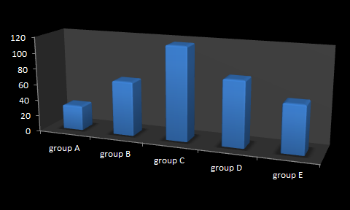
CATEGORIZATION BASED ON TEST PREPARATION COURSE COMPLETED AND RACE
FINDINGS:
The Race GROUP C has maximum number of students who have completed the course.
The Race Group A has the minimum number of students who have completed the course.
The Race GROUP D and GROUP B have the average number of students to complete the course.

Slide 16
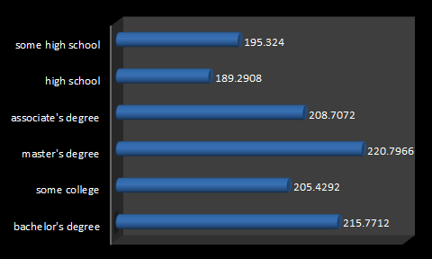
CATEGORIZATION BASED ON PARENTAL LEVEL OF EDUCATION
FINDINGS:
The Students whose Parental Education is Masters degree,Bachelor’s Degree ,Associate’s Degree and Some College have performed well than the students whose Parental Education is Some high school and High School

Slide 17
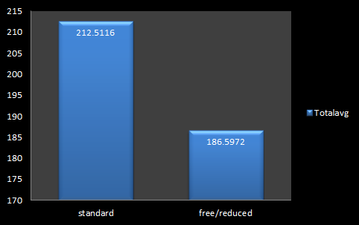
CATEGORIZATION BASED ON LUNCH
FINDINGS:
The Students who have been served with Standard lunch has scored more than the Students who have been served free/reduced meals.

Slide 18
CONCLUSION
To maintain the gender diversity more number of male students should be enrolled.
To main race-wise diversity students belonging to GROUP A and GROUP B should be enrolled into the School.
In order to improve the performance more focus should be given to the male students(gender-wise) and to the students belonging to GROUP A and GROUP B (race-wise) and to the subject Maths.
Encourage more students to take a Test-Preparation course specifically the male students(gender-wise) and the students of race GROUP A and GROUP B as it is observed that the course helps in improvement of the performance.

Slide 19
CONCLUSION
Parents Level Education also plays an role in the performance of students.The Students whose Parental Education is Masters degree,Bachelor’s Degree, Associate’s Degree and Some College have performed well than the students whose Parental Education is Some high school and High School.
The Students Having Standard Lunch have a better performance than the students having free/reduced lunch.Thus the school should provide Standard Lunch to all the students.
The above conclusions will help in improving the performance of the Students in future.

Slide 20
THANK YOU.

